Slide 1







OT
OneTrust
OneTrust GTM Intelligence Report
Prepared by Will Salako | Senior Data Analyst | October 2025
Stakeholders: (Internal – Confidential)
Strength in Trust

Slide 2
OT
OneTrust
Assessment Overview
In this GTM Consulting project I was tasked with analyzing OneTrust’s Go-To-Market (GTM) performance data to demonstrate my ability to transform raw sales and renewal data into actionable business insights
The goal is to apply technical, analytical, and strategic thinking to produce key insights that highlights key performance drivers across sales, renewals, churn, and retention.
To complete the assessment:
I modeled and cleaned the dataset using Excel/SQL/Power BI
Applied DAX calculations to create fiscal year/quarter logic aligned with OneTrust’s financial calendar
Built visuals that show Sales by Close Date, Renewal & Churn by Expiration Date, and key SaaS metrics such as ARR, GRR, NRR, and Renewal Rate
Interpreted these metrics to provide business recommendations for leadership.
Strength in Trust

Slide 3











OT
OneTrust
Business Objective & Context
GTM Mission
Primary Goals
Enabling organizations to responsibly utilize data and artificial intelligence through comprehensive privacy and security solutions.
Identify key revenue drivers
Assess renewal performance
Evaluate retention efficiency
Dashboard Context
Problem Solved
Built to enhance business visibility into sales performance, monitor renewal health, and track revenue retention trends.
Consolidates fragmented visibility between sales performance (ARR growth) and customer retention (renewal + churn).
OneTrust GTM Intelligence Report

Slide 4










OT
OneTrust
Approach to Data Preparation
Technical Approach
Tools Used
Raw Data Import
Imported Excel data into Power BI
SQL
Power Query
Calculated Columns
Initial data manipulation and querying
Data transformation and cleansing
Added FYQ columns (fiscal year starting Feb 1)
Key Measures
Built measures for Sales, Renewal, ARR, GRR, NRR
DAX
Data Modeling
Time-Series Analysis
Complex measures and calculated columns
Dynamic slicing and dicing capabilities
Created visualizations by Close Date and Expiration Date
Conclusion: This structured approach created a clean, executive-level reporting dashboard that provides accurate, reliable insights for strategic decision-making
OneTrust GTM Intelligence Report

Slide 5







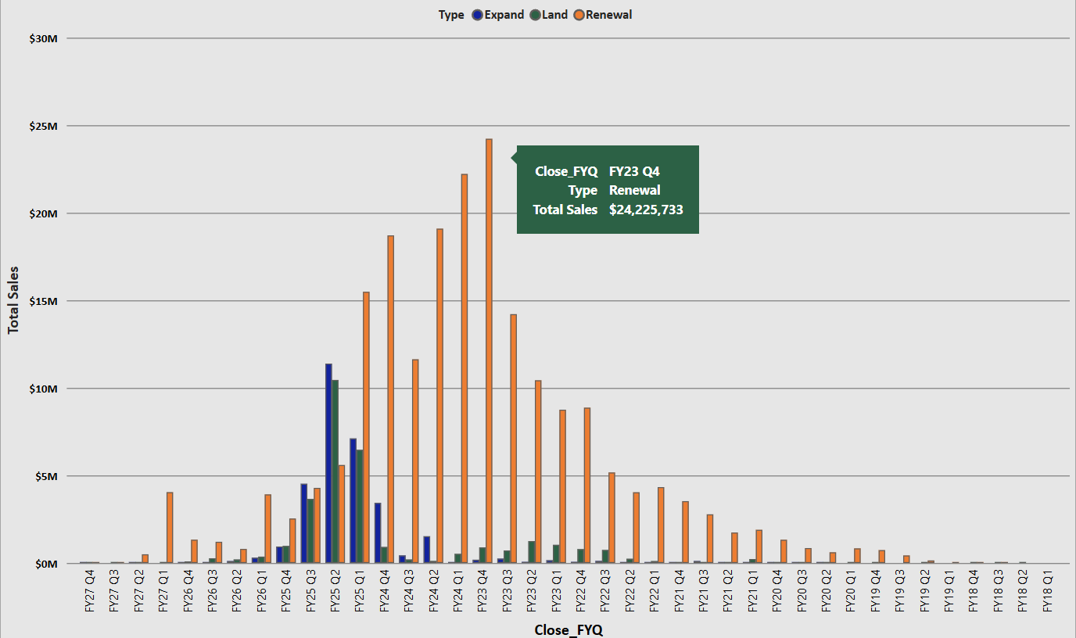




OT
OneTrust
Key Insights
Business Insights: Sales Performance
Land opportunities rebounded with $10.5M in FY25 Q2 showing renewed momentum in customer acquisition as organizations resumed privacy tech investments following 2023’s IT budget constraints
Sales Amount by Opportunity Type
Expand opportunities reached $11.4M in FY25 Q2 confirming strong cross-sell traction across OneTrust’s compliance, GRC and AI governance solutions (sign of growing customer maturity & platform dependency)
Renewal opportunities peaked at $24.2M in FY23 Q4 reflecting resilient enterprise retention and contract renewals fueled by global privacy legislation and rising regulatory complexity
Strategic Implications
Peak Performance
OneTrust's balanced approach leverages both new customer acquisition and existing customer value maximization
FY23 Q4 saw exceptional Renewal sales growth: $24,225,733
FY25Q2 saw exceptional Expansion sales growth: $11,390,549
FY25Q2 saw exceptional Land sales growth: $10,455,014
This dual strategy effectively drives ARR expansion, demonstrating a mature Go-To-Market approach
OneTrust GTM Intelligence Report

Slide 6






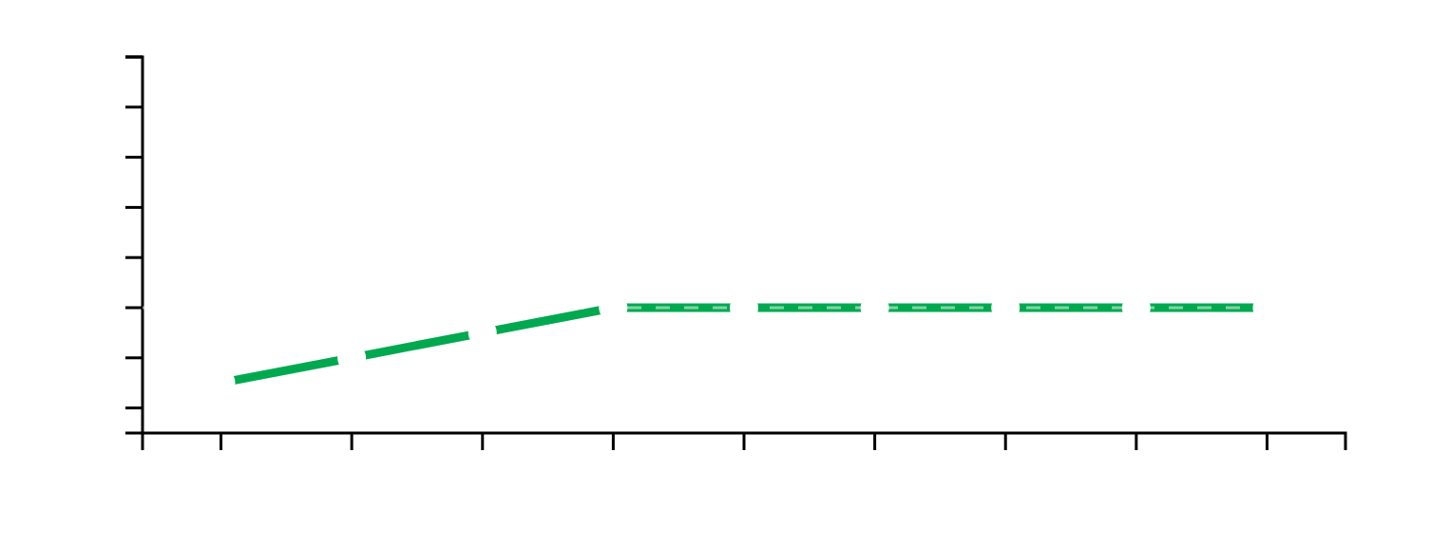
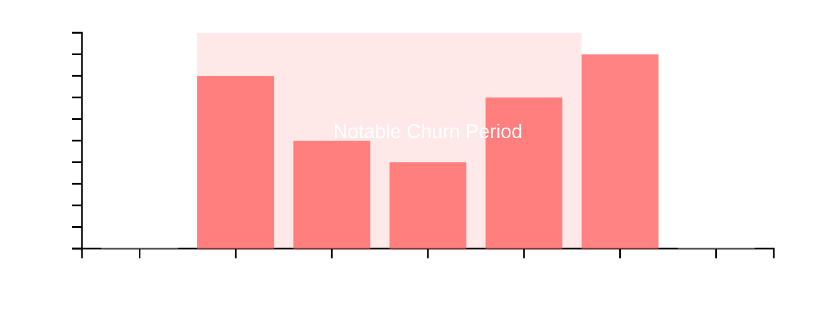







OT
OneTrust
Business Insights: Renewals & Churn
Renewal Rate Analysis
Churn Periods & Context
Key Insight:
Notable Churn:
Renewal rate consistently stabilizes near 90%, indicating strong retention capability and high customer satisfaction.
Observed around FY23–FY24 Q1, often correlating with product migrations or pricing changes.
Benchmark:
Business Context:
OneTrust's renewal rate of 90% is considered strong within the SaaS industry, where rates above 85-90% are typically benchmarked as healthy.
In OneTrust's subscription model, churn often results from product overlap or account consolidation, requiring targeted strategies.
OneTrust GTM Intelligence Report

Slide 7


















OT
OneTrust
Operational KPIs & Efficiency
Total ARR
Total Renewal
Total Churn
GRR
$145.9M
$1.17B
$129.6M
90%
Deal Count
Avg Deal Size
Expansion ARR
155K
$2.2K
$5.4M
Key Insights
ARR growth balanced between new acquisition and expansion
Strong GRR (90%) shows low customer attrition
Volume-driven GTM with 65K deals at $2.2K average
SaaS model maturity providing predictable revenue
OneTrust GTM Intelligence Report

Slide 8















OT
OneTrust
Why This Data Matters
Executive Decisions
SaaS Success Metric
Revenue Forecasting & Sales Strategy
GRR and NRR trends are critical indicators of success in the SaaS industry.
Provides insights into past performance to accurately project future revenue and refine sales approaches for new acquisitions and expansions.
Renewal Health & Customer Segmentation
Enables proactive identification of at-risk accounts and opportunities for targeted engagement, allowing for effective customer segmentation strategies.
Product Adoption & Upsell Prioritization
Highlights areas where product adoption may be lagging or where upsell potential is highest, guiding product development and sales efforts.
Leadership View
This dashboard provides a unified view of growth and retention alignment, ensuring predictable ARR growth and supporting strategic planning for sustained business expansion.
OneTrust GTM Intelligence Report

Slide 9














OT
OneTrust
Recommendations & Next Steps
Strategic Recommendations
Implementation Roadmap
Focus on Expansion Programs
1
Automate Data Refresh
Ensure dashboard reflects current performance metrics
Target strategies to drive customer expansion and increase NRR above 115%
2
Enable Stakeholder Access
Segmented Churn Analysis
Facilitate self-service analytics via Power BI Service
Analyze churn by region, product, and customer size for tailored retention strategies
Expand ARR Modeling
3
Incorporate product categories for granular revenue analysis
Power BI Alert Integration
Monitor renewal rate drops for immediate intervention and investigation
"Leveraging data to drive strategic decisions and ensure predictable ARR growth."
Salesforce Integration
Integrate dashboard into Salesforce for real-time customer health visibility
OneTrust GTM Intelligence Report

Slide 10









OT
OneTrust
Thank You
OneTrust GTM Intelligence Report
Thank you for your time and attention to the OneTrust GTM Intelligence Report. This presentation, prepared by Will Salako, Senior Data Analyst, aims to provide actionable insights into our sales performance, renewal health, and revenue retention trends.
OneTrust: Strength in Trust
Report Date: October 15, 2025
Prepared by Will Salako | Senior Data Analyst

